Slide 1
New York City Leading Causes of Death
Addis, Anna, Kyle, Jaber and Nick
Group name: the death of us

Slide 2
Links
https://data.cityofnewyork.us/Health/New-York-City-Leading-Causes-of-Death/jb7j-dtam
https://github.com/ADIETH/Project2/blob/master/NY/Lead_Dath_rate.ipynb
https://hopeworkny.herokuapp.com/
https://github.com/ADIETH/Project2/blob/master/NY/app.py

Slide 3
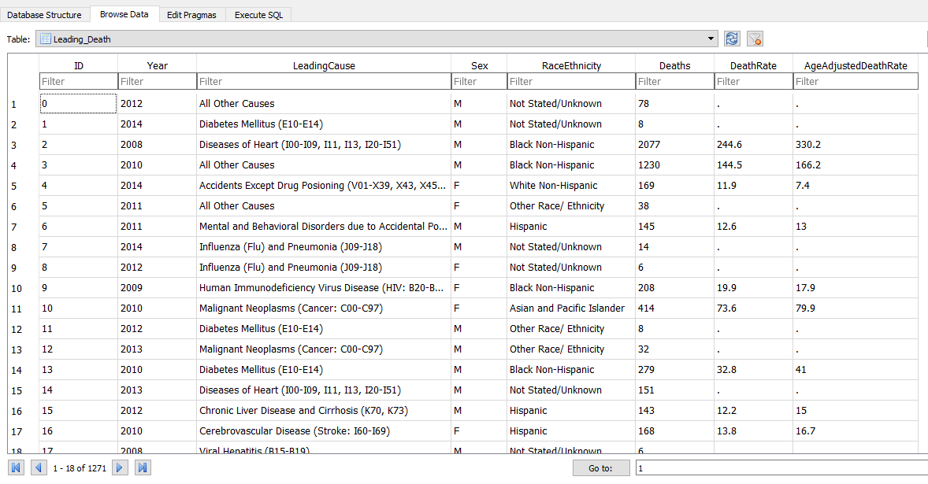
SQLITE Database – Original Code

Slide 4
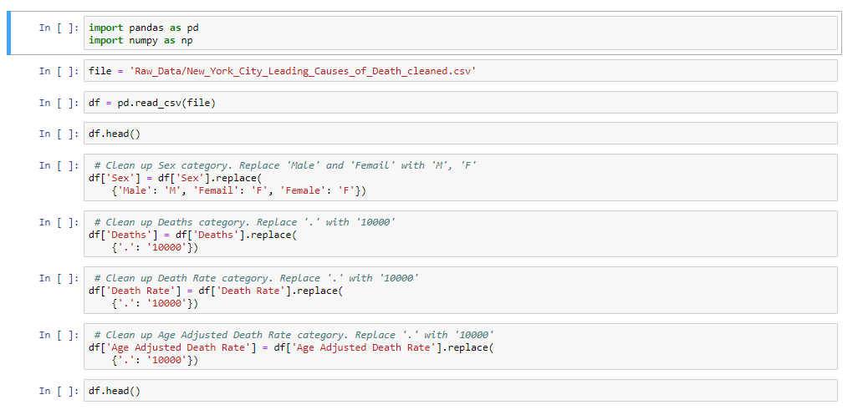
Jupyter Notebook – Cleanup Process

Slide 5
Never-Used Library
Crossfilter Javascript Library:
Used for exploring large datasets that involve two or more variable quantities in the browser

Slide 6
Dashboard

